Slide 1
DevOps – The Journey
Gajendran V
Mail To: gajendranv@gmail.com

Slide 2
Course Topics
DevOps Session - I
01 | Overview | 04 | Benefits | 07 | Objectives
02 | History | 05 | The Term Fundamental | 08 | Open Source Eco System
03 | Dev and Ops | 06 | ALM – Gartner View | 09 | Overview of CI & CD

Slide 3


Traditional Development and Operations
DEV
OPS
Notes:
Taken from: http://dev2ops.org/2010/02/what-is-devops/
Development kicks things off by “tossing” a software release “over the wall” to Operations. Operations picks up the release artifacts and begins preparing for their deployment. Operations manually hacks the deployment scripts provided by the developers or creates their own scripts. They also hand edit configuration files to reflect the production environment, which is significantly different than the Development or QA environments. At best they are duplicating work that was already done in previous environments, at worst they are about to introduce or uncover new bugs.
Operations then embarks on what they understand to be the currently correct deployment process, which at this point is essentially being performed for the first time due to the script, configuration, process, and environment differences between Development and Operations. Of course, somewhere along the way a problem occurs and the developers are called in to help troubleshoot. Operations claims that Development gave them faulty artifacts. Developers respond by pointing out that it worked just fine in their environments, so it must be the case that Operations did something wrong. Developers are having a difficult time even diagnosing the problem because the configuration, file locations, and procedure used to get into this state is different then what they expect (if security policies even allow them to access the production servers!).
Time is running out on the change window and, of course, there isn’t a reliable way to roll the environment back to a previously known good state. So what should have been an eventless deployment ended up being an all-hands-on-deck fire drill where a lot of trial and error finally hacked the production environment into a usable state.

Slide 4
DevOps Overview
DevOps is the practice of operations and development engineers participating together in the entire service lifecycle, from design through the development process to production support.
DevOps is also characterized by operations staff making use many of the same techniques as developers for their systems work.

Slide 5


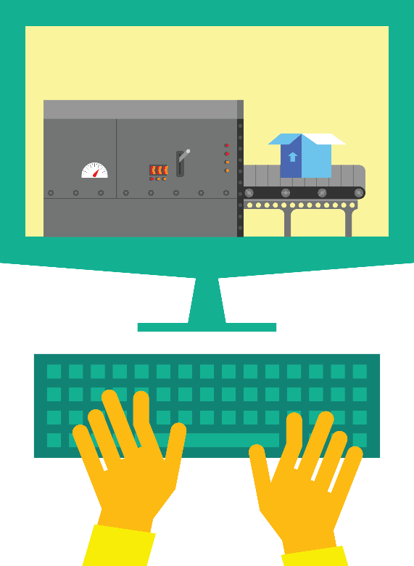

DevOps: The three stage conversation
1
People
2
Process
3
Products
Notes:
People = Culture
Fundamental attributes of successful cultures:
Shared mission and incentives: infrastructure as code, apps as services, DevOps/all as teams
You need to consider your hardware as a commodity, (don't give your servers names) , servers are like farm animals, it is just harder if you let theids name them
Build deep instrumentation into services, push complexity up the stack
Rally around agile, shared metrics, CI, service owners on call, etc.
Changing the culture: any change takes time, changing culture is no exception and you can't do it alone, exploit compelling events to change culture: downtimes, cloud adoption, devops buzz
PROCESS Definition and design, compliance, and continuous improvement
PEOPLE Responsibilities, management, skills development, and discipline
Products Tools and infrastructure

Slide 6
DevOps – The IT Company Standpoint
Business
Agility
Time-to-Market Acceleration
Experimentation
Rapid Prototyping
Flexible Partnering
Business
Agility
Tech Innovation
DevOps Automation
API Support
Application Scaling and Elasticity
PaaS
SaaS & IaaS
Tech Innovation
DevOps
Infra Choice
Infra Choice
Containerization
Language and Stack Neutral
Lightweight Hybrid cloud
Late Binding deployments
Common Application Design and Operations

Slide 7
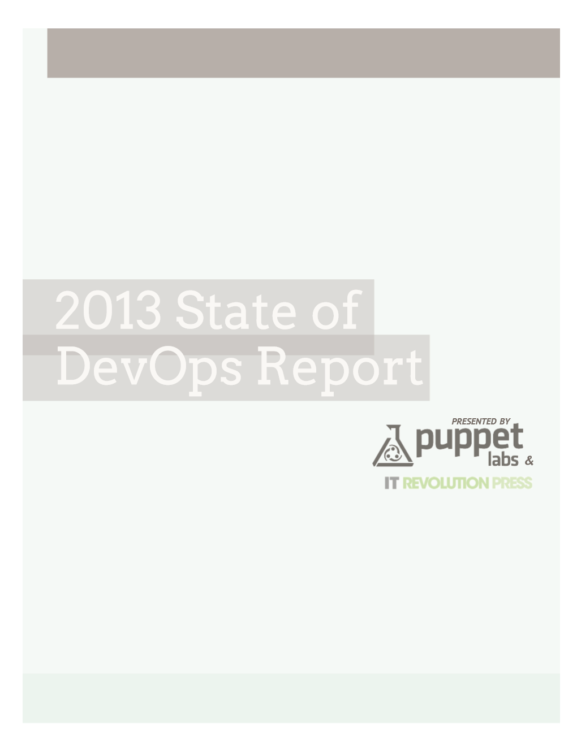
Benefits
Key findings:
Organizations that implemented DevOps reported:
ORGANIZATIONS THAT HAVE IMPLEMENTED DEVOPS SAW THESE BENEFITS:
Improved quality of software deployments
High performance and reliability
IMPROVED QUALITY OF SOFTWARE DEPLOYMENTS
65%
MORE FREQUENT SOFTWARE RELEASES
63%
TOP 5 TOOLS USED TO SUPPORT DEVOPS INITIATIVES
IMPROVED VISIBILITY INTO IT
PROCESS AND REQUIREMENTS
61%
VERSION CONTROL SYSTEMS
84%
CULTURAL CHANGE
COLLABORATION/COOPERATION
55%
CONFIGURATION MANAGEMENT
78%
MORE RESPONSIVENESS TO BUSINESS NEEDS
55%
Source: https://puppetlabs.com/
MORE AGILE DEVELOPMENT
51%
TICKETING SYSTEM
68%
Ship code 30x faster
and complete those deployments 8,000 times faster than their peers.
Have 50% fewer failures
and restore service 12 times faster than their peers.
MORE AGILE CHANGE MANAGEMENT PROCESS
45%
RESOURCE MONITORING
60%
PROVISIONING
56%
IMPROVED QUALITY OF CODE
38%

Slide 8
Foundational DevOps terms
PROCESS
MTTD – Mean time to detection
MTTF – Mean time to failure
MTBF – Mean time between failures
MTTR – Mean time to resolution
Continuous Delivery
Automated testing, Continuous integration, Continuous deployment
Notes:
This is your output to measure

Slide 9
Gartner view of ALM
OPERATE
ANALYZE
MONITOR
DEPLOY
OPS
CODE
BUILD
UNIT TEST
INTEGRATION TEST
LOAD TEST
ASSESS
DESIGN
RELEASE
PLAN
CODE
BUILD
UNIT TEST
REGRESSION TEST
FUNCTION TEST
DEVELOP + TEST
RELEASE
TEST
DEV
CODE
BUILD
UNIT TEST

Slide 10
Objectives

Slide 11



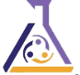












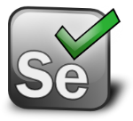




Open source ecosystem
Source
Build
Deploy
App
Ops
GitHub
Codeplex
Chef
Puppet Labs
Public Cloud
Jenkins
Hudson
Microsoft Azure
Alerting
Configuration
Grunt
Gradle
Jenkins
Hudson
Linux
Zabbix
Cacti
On-premises
Monitor
Test/issues
Gradle
Vagrant
Travis
Fog
Grunt
Visual Studio
Puppet Labs
Eclipse
Selenium
Process tools
Redmine
JIRA
Notes:
http://www.redmine.org/
https://www.atlassian.com/software/jira/

Slide 12
Overview of CI
Continuous Integration (CI) is a development practice that requires developers to integrate code into a shared repository several times a day. Each check-in is then verified by an automated build, allowing teams to detect problems early.
integrating regularly, you can detect errors quickly, and locate them more easily.
Solve problems Quickly
Benefits
Say goodbye to long and tense integrations
Increase visibility which enables greater communication
Catch issues fast and nip them in the bud
Spend less time debugging and more time adding features
Proceed in the confidence you’re building on a solid foundation
Stop waiting to find out if your code’s going to work
Reduce integration problems allowing you to deliver software more rapidly
“Continuous Integration doesn’t get rid of bugs, but it does make them dramatically easier to find and remove.”

Slide 13
CI Principle and Practices
Practices
Maintain a single source repository
How to do it
Developers check out code into their private workspaces.
Team Responsibility
Check in frequently
Continuous Deployment
it is the practice of releasing every good build to users
Automate the build
Make your build self-testing
Every commit should build on an integration machine
Keep the build fast
Test in a clone of the production environment
Make it easy for anyone to get the latest executable
Everyone can see what’s happening
Automate deployment
When done, commit the changes to the repository.
The CI server monitors the repository and checks out changes when they occur.
The CI server builds the system and runs unit and integration tests.
The CI server releases deployable artefacts for testing.
The CI server assigns a build label to the version of the code it just built.
The CI server informs the team of the successful build.
If the build or tests fail, the CI server alerts the team.
The team fix the issue at the earliest opportunity.
Continue to continually integrate and test throughout the project.
Don’t check in broken code
Don’t check in untested code
Don’t check in when the build is broken
Don’t go home after checking in until the system builds
adopting both Continuous Integration and Continuous Deployment, you not only reduce risks and catch bugs quickly, but also move rapidly to working software
Notes:
This is your output to measure

Slide 14
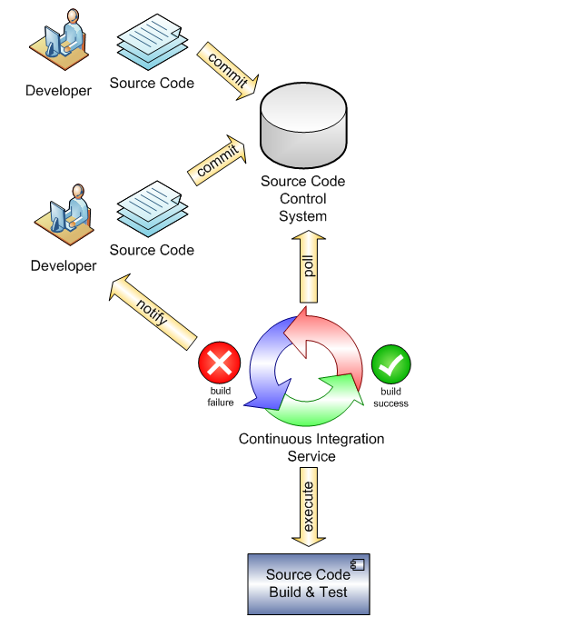
CI Process

Slide 15
Overview of CD
Continuous deployment can be thought of as an extension of continuous integration, aiming at minimizing lead time, the time elapsed between development writing one new line of code and this new code being used by live users, in production
Benefits
earlier return on investment for each feature after it is developed, which reduces the need for large capital investments
earlier feedback from users on each new feature as it is released to production, which affords techniques such as parallel (or A/B) testing to determine which of two possible implementation is preferred by users
Costs
continuous deployment relies on extensive instrumentation to ensure that functionality newly made available to users does not result in incidents, lowering externally perceived quality
Increased Quality

Slide 16
Key Takeaways
Understand the DevOps Model
Get Engaged with DevOps Conversation
Understand different types of tools
Understand DevOps Importance in the Market

